Slide 1



EU Data Law series
Consumer Law in the Digital Age
Prof. Francisco de Elizalde
Jean Monnet Chair in EU Digital Private Law
Associate Professor, IE University (Madrid)
Visiting Professor, Koç University (Istanbul)
D-Law, University of Bologna

Slide 2

Outline 1. Consumer law 2. Consumer law in the digital age

Slide 3

EU consumer law

Slide 4

The origins of consumer protection
JF Kennedy
The factual basis
Consumer law as the law of individuals
From contract law (equalness) to consumer protection (imbalance): information & power

Slide 5

The origins of EU Consumer law
From Consumer protection to Consumer law: from national to EU (SEA)
Art 114 TFEU
Early interests v market (economic) interests
Competition & Consumer in ordoliberalism

Slide 6
The consumer acquis
Unfair Terms Directive (93/13/EEC, UTD)
Unfair Commercial Practices Directive (2005/29, reformed by Dir. 2019/2161, UCPD)
Consumer Rights Directive (2011/83, CRD)
Digital Content Directive (2019/770, DCD)
Consumer Sales Directive (2019/771, CSD)

Slide 7

Key legal rules
The B2C relationship
The legal assumption: the reasonable consumer
The information paradigm (Market-enhancing)
Unfairness (Market-rectifying)

Slide 8

The position-logic

Slide 9


Consumer Law
The position-logic (B2B, B2C, C2C)

Slide 10
Consumer Law
The position-logic (B2B, B2C, C2C)
Objective definition

Slide 11

Consumer Law
Objective definition
‘consumer’ means any natural person who, in contracts covered by this Directive, is acting for purposes which are outside his trade, business or profession

Slide 12
Consumer Law
Objective definition
‘consumer’ means any natural person who, in contracts covered by this Directive, is acting for purposes which are outside his trade, business or profession
‘seller/supplier/trader’ means any natural or legal person who, in contracts covered by this Directive, is acting for purposes relating to his trade, business or profession

Slide 13

Consumer Law
The consumer as weak v business: information & power
But reasonable, rational, well-informed

Slide 14
Consumer Law
From agreement to ‘the average’
CJEU in Costea, Schrems, and Jana Petruchová

Slide 15
Enhancing choice

Slide 16

Unfair practices

Slide 17
Consumer Law
UCPD (2005/29)
Misleading actions
1. A commercial practice shall be regarded as misleading if it contains false information and is therefore untruthful or in any way, including overall presentation, deceives or is likely to deceive the average consumer, even if the information is factually correct, in relation to one or more of the following elements, and in either case causes or is likely to cause him to take a transactional decision that he would not have taken otherwise:

Slide 18
Consumer Law
Article 7
Misleading omissions
1. A commercial practice shall be regarded as misleading if, in its factual context, taking account of all its features and circumstances and the limitations of the communication medium, it omits material information that the average consumer needs, according to the context, to take an informed transactional decision and thereby causes or is likely to cause the average consumer to take a transactional decision that he would not have taken otherwise.

Slide 19
Consumer Law
Article 8
Aggressive commercial practices
A commercial practice shall be regarded as aggressive if, in its factual context, taking account of all its features and circumstances, by harassment, coercion, including the use of physical force, or undue influence, it significantly impairs or is likely to significantly impair the average consumer's freedom of choice or conduct with regard to the product and thereby causes him or is likely to cause him to take a transactional decision that he would not have taken otherwise.

Slide 20

Surfing online
Classification of results:
Explain (Art 7.4a UCPD). Not search engines
Non-disclosure of payments (Annex I, 11a UCPD)

Slide 21
Surfing online
Reviews:
If and how (Art 7.6 UCPD)
Lack of diligence (Annex I, 23b UCPD)

Slide 22
Transparent terms

Slide 23
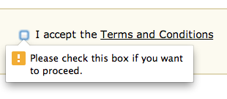
The terms!

Slide 24
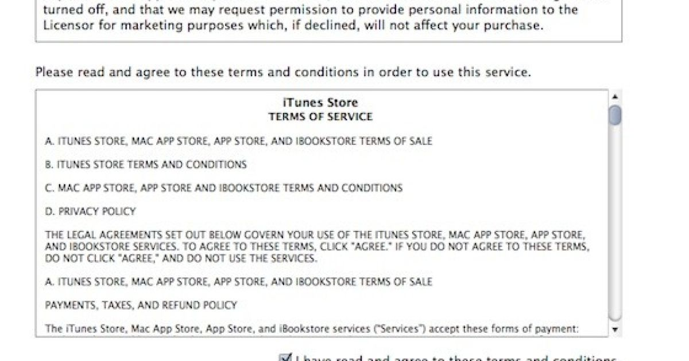
Standard form contracts

Slide 25


Slide 26


Slide 27
Transparency in the UCTD (Dir. 93/13)
‘Plain intelligible language’ (Arts 4(2) & 5):
that an average consumer can foresee the economic consequences of a term (CJEU in Kásler)

Slide 28
Market rectifying: unfair terms & quality

Slide 29
UTD (Dir 93/13): Standard terms
Ancillary
Main:
All but main: significant imbalance in the rights & obligations (Art 3(1)
Subject matter
Adequacy price/good or service

Slide 30

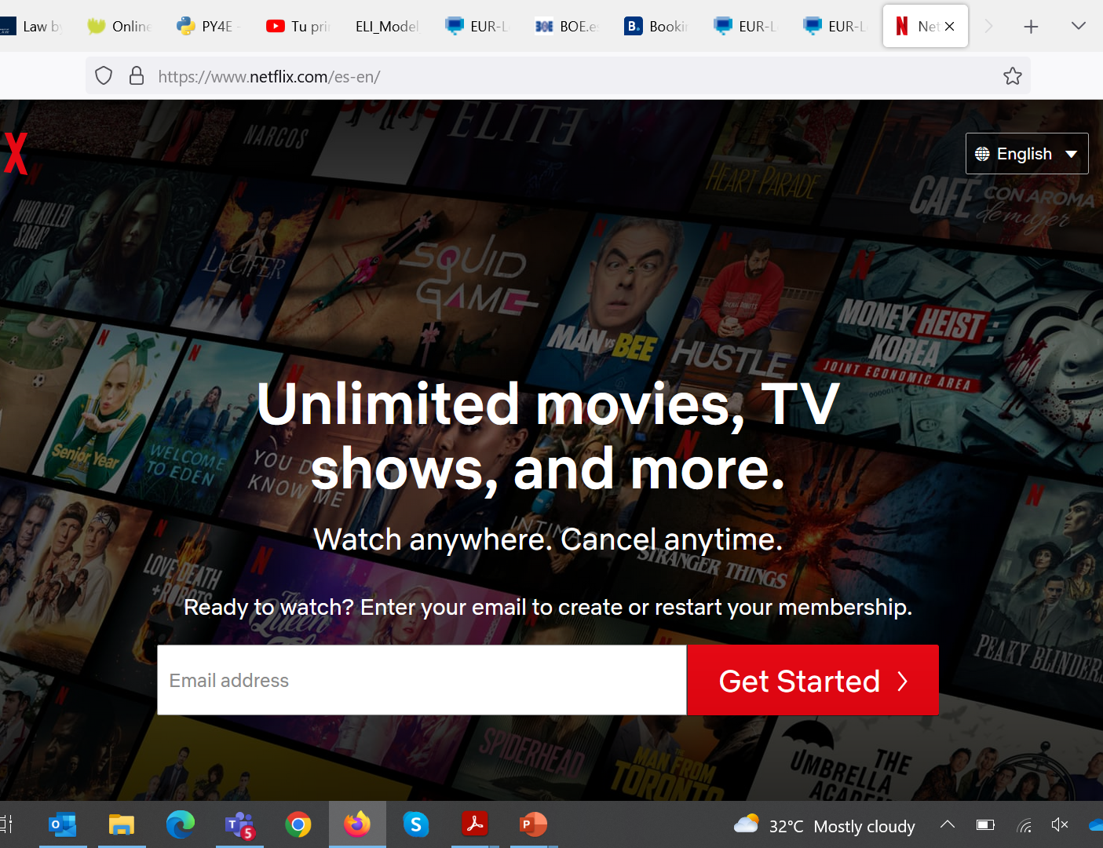
Mandatory quality requirements
Dir. 2019/770: digital content and digital services
Dir. 2019/771: sale of goods

Slide 31
Effects on enforcement
Individual (expertise)
Re-establishing power imbalances
Collective (commonalities)
Public Enforcement

Slide 32

From individualised to structural consumer law in the digital environment

Slide 33

A new economic reality: from the industrial to the digital age

Slide 34

From consumption to citizenship

Slide 35

Consumption in the digital age & citizenship
Access to goods & services (e.g. banks)
Political views following consumption (e.g. newspapers)
Communications (social networks & web 3.0)
IoT (e.g. health information)
Esta foto de Autor desconocido está bajo licencia CC BY

Slide 36

Data and consumers
Data as part of the service (IoT)
Conditions of the service: profiling, advertising, personalizing
Influence decision-making
Counter-performance

Slide 37

Data and consumers
Architectural & relational vulnerability

Slide 38
The legal response

Slide 39

The digital legal framework
Digital Services Act (Regulation 2022/2065)
Digital Markets Act (Regulation 2022/1925)
Data Act (Regulation 2023/2854)
Data Governance Act (2022/868)
AI Act (Regulation 2024/1689)

Slide 40
A new framework for market regulation
The failure of competition law
The flaws of consumer law
Systemic risk governance: from banking to digital

Slide 41
An asymmetric regulation
Gatekeepers (DMA)
Very large online platforms and very large online search engines
Designated by the Commission

Slide 42

VLOPs and VLOSEs

Slide 43
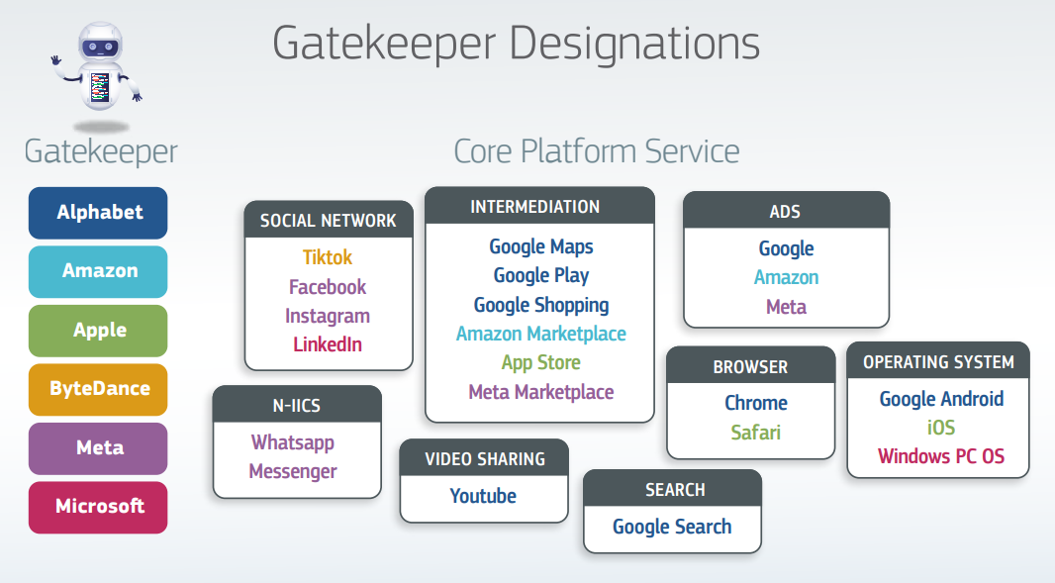
Gatekeepers under the DMA

Slide 44

Consequences for individuals

Slide 45
The consequences of an asymmetric regulation
B2C no longer the criterium (users, end users, recipients of the service)
From information to power language (‘serious imbalances in the bargaining power’, Recital 4 DMA)

Slide 46
First layer of impact: structuralised consumer law?
Further Consumer vulnerability? Less freedom (EDPB, Opinion 8/2024; CJEU in Meta 2023)?
Easier to claim unfair practices that are structural? E.g. dark patterns? (Art 25 DSA)

Slide 47
Private ordering of society
Extra economic interests (health, democracy, fundamental rights)
Risk as an approach to regulation of private relationships
Regulation by code

Slide 48
Second layer of impact: systemic risk regulation
Systemic risk regulation, consumer protection and constitutional law

Slide 49
Code, market and society: an example
Art 3(1) UCTD. Unfair term if it causes:
a significant imbalance in the rights & obligations
Against good faith
to the detriment of the consumer
Art 14(4) DSA (on terms)
Providers of intermediary services shall act in a diligent, objective and proportionate manner in applying and enforcing the restrictions referred to in paragraph 1 [terms], with due regard to the rights and legitimate interests of all parties involved, including the fundamental rights of the recipients of the service, such as the freedom of expression, freedom and pluralism of the media, and other fundamental rights and freedoms as enshrined in the Charter

Slide 50
Second layer of impact: privatisation
Governance with ToS: DSA v Terrorist Content Regulation & Copyright in the Digital Single Market (Poland v EP)
Algorithmic self-enforcement (+ Codes of conduct, auditing, etc.)
From economic unfairness to defining illegality (limit: fundamental rights)

Slide 51
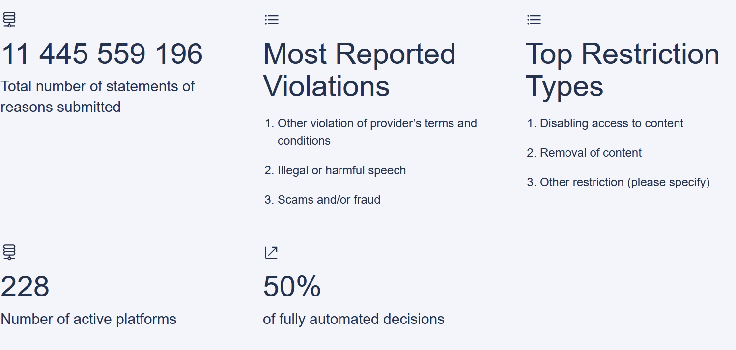
Code is law: DSA Transparency Database

Slide 52
Third layer of impact: consumer law?
From content to procedure: the UCTD experience (flexibilising what a ‘term’ is? –FIFA experience)
Direct control of illegality (e.g. v GDPR)

Slide 53
Third layer of impact: consumer law?
Institutional control?
Operationalisation of fundamental rights as a limit? How to merge it with consumer law as a welfarist tool?
Digital Fairness Act?

Slide 54
Prof. Francisco de Elizalde
IE University
D-Law – University of Bologna
francisco.deelizalde@ie.edu
D-Law Coordinator: Prof. Federico Ferretti, University of Bologna
f.ferretti@unibo.it

